Slide 1
Project Idea Submission CSE-306
Group 29

Slide 2
Group Members
Lt. Salman Rahman - 201814107
A.S.M. Rakibul Hasan - 201914056
Shad Reza - 201914024

Slide 3
Idea : Fire & Gas Alarm System
Here there will be a sensing done for excessive smoke or the temperature that exceeds the threshold level.
If in dangerous level then hazard signal would be shown in the output display
Also for the alarming there will be a sound alarm and also the lights will go blinking for the in this situation to warn everybody.
Lastly the doors and the windows [will be represented by LEDs] will be opened to reduce the damage.
Field of Application : Kitchen, Room, Office, Workspaces, etc… Required Tools : Arduino, Display, LED, Sensor, Software tools, etc...

Slide 4
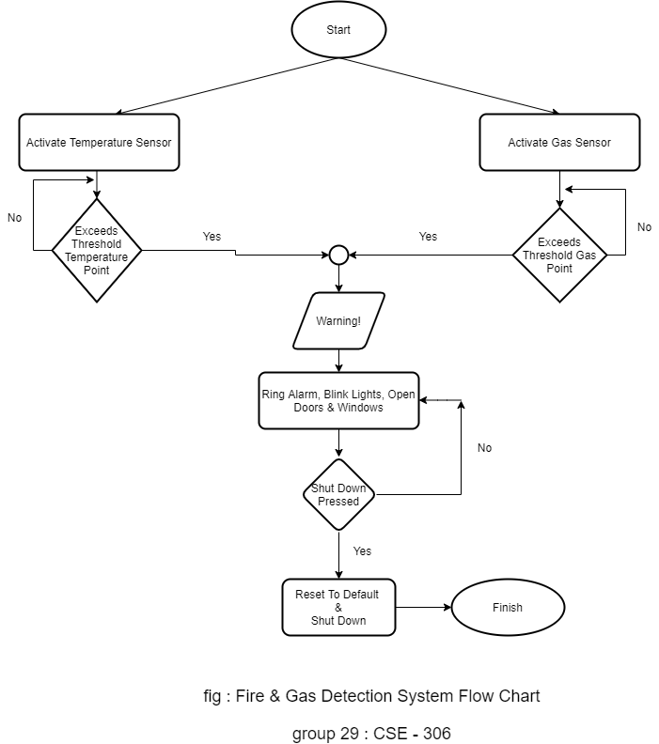

Slide 5
Required Sensors & Tools
Tools :
Arduino
Proteus
Sensors :
LM35 temperature sensor
MQ-4 gas sensor

Slide 7
Idea 01 : Traffic Light Controller
Traffic light controller helps movement of the riders & also helps conducting an orderly flow by giving right of way to the vehicles. Here we will automate the traffic light system on the basis of time. They help reduce the number of accidents and make collisions at intersections a lot less frequent.

Slide 8
Idea 02 : Password Generator
This is a project is a general representation of a random password generator. The user will give us a number and we will generate a random password of that much bits. Here we will be using a random value generator which will be an user defined function

Slide 9
Idea 04 : Fingerprint Attendance System
One can enroll himself via the fingerprint sensor.
After a successful enrollment one can get to see the credentials generated by the code
This will also detect faulty finger pressing or no finger pressing Applicable Fields: Offices, Educational Institutions, etc Required tools:
Arduino, Fingerprint Sensor, Display, Software tools, etc...

Slide 10
Idea 05 : Gas Detector System
If the sensor sense gas then it will display the hazard in the display
Also there will be LEDs that will be blinking in a unique pattern to let everyone know about the hazard.
Also there will be LEDs that represents a door and windows which will be opened while the gas is detected. Applicable Fields: Kitchens, Rooms, Offices, etc Required Tools: Arduino, Display, LED, Gas Sensor, Software tools, etc...

Slide 11
Thank you!

